Slide 1
Understanding the Intersecting Syndemics of Communicable and Non-Communicable Diseases
Emily P. Hyle, MD MSc
Division of Infectious Diseases
Massachusetts General Hospital
Harvard Medical School

Slide 2
Financial disclosures
I have no financial disclosures

Slide 3
HIV and TB are synergistic
HIV
TB
Adapted from Tsai et al. Soc Sci Med 2018

Slide 4
Additional impact of diabetes (DM)
DM
HIV
TB
Adapted from Tsai et al. Soc Sci Med 2018

Slide 5
Influence of structural barriers to care
DM
HIV
TB
Economic instability
Food insecurity
Adapted from Tsai et al. Soc Sci Med 2018

Slide 6
Syndemics framework
Health conditions co-occur due to adverse social conditions and interact synergistically
A broad view of the challenges contributing to multimorbidity that includes social, behavioral, and biologic interactions
Singer et al. Med Anthropol Q 2003; Singer et al. Lancet 2017

Slide 7
Road map
Challenges and successes of global HIV treatment scale-up
HIV co-exists with a wide range of other health-related issues
Syndemics framework suggests opportunities to maximize impact

Slide 8
Road map
Challenges and successes of global HIV treatment scale-up
HIV co-exists with a wide range of other health-related issues
Syndemics framework suggests opportunities to maximize impact

Slide 9
Challenges and successes in HIV/AIDS
940,000 AIDS-related deaths
1.8 million new infections
Rising HIV incidence in 50 countries
UNAIDS Global AIDS Update 2018

Slide 10
Almost 60% of PWH on ART worldwide
UNAIDS Global AIDS Update 2018

Slide 11
Global HIV care cascade
UNAIDS Global AIDS Update 2018

Slide 12
Life expectancy of PWH on ART
In US, Canada, and Europe, a 20 yo PWH who achieves a CD4 >350/μL within a year of starting ART can expect to live to 78y
In South Africa, the difference in life expectancies between PWH and HIV-uninfected has shrunk to 1.2y for men and 5.3y for women
ART-CC Lancet HIV 2017; Reniers et al. Lancet HIV 2017

Slide 13
PWH on ART have multimorbidity
Wong et al. CID 2018

Slide 14
Road map
Challenges and successes of global HIV treatment scale-up
HIV co-exists with a wide range of other health-related issues
Syndemics framework suggests opportunities to maximize impact

Slide 15
TB deaths have not declined steeply
HIV deaths
TB deaths in
people without HIV
TB deaths in
people with HIV
WHO Global Tuberculosis Report 2017

Slide 16
TB care cascade in India
Subbaraman et al. PLoS Med 2016

Slide 17
Hepatitis deaths are rising worldwide
WHO Global Hepatitis Report 2017

Slide 18
Most common causes of deaths globally
WHO Global Health Estimates 2016

Slide 19
Most common causes of deaths globally
WHO Global Health Estimates 2016

Slide 20
High-income countries (GNI per capita > $12,056)
WHO Global Health Estimates 2016, World Bank 2017

Slide 21
WHO Global Health Estimates 2016, World Bank 2017

Slide 22
WHO Global Health Estimates 2016, World Bank 2017

Slide 23
WHO Global Health Estimates 2016, World Bank 2017

Slide 24
Pollution is a major contributor to mortality
Landrigan et al. Lancet 2018

Slide 25
Too many deaths from tobacco
Landrigan et al. Lancet 2018

Slide 26
Tobacco use increases mortality
Increased risk of TB, cancers, COPD, CVD, and stroke
In 2015, 6.4 million deaths (11.5%) were attributable to smoking worldwide
In Asia, 2 million deaths of adults 45 years or older were attributable to smoking in 2014
19.1% of all deaths in Asia that year
GBD 2015 Tobacco Collaborators Lancet 2017; Zheng et al. PLoS Medicine 2014

Slide 27
Impact of tobacco on PWH mortality
-X
=Years of life lost, compared to never smokers
-1.0
-6.7
Reddy et al. JID 2016

Slide 28
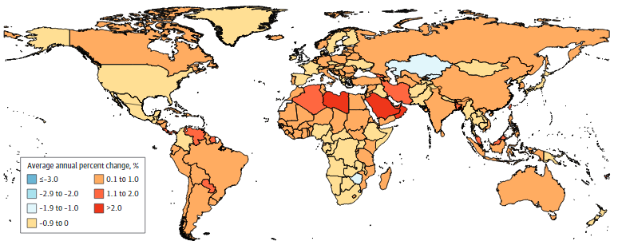
Cancer cases are increasing worldwide
28% more cancer cases in 2016 compared to 2006
Global Burden of Diseases Cancer Collaboration JAMA Oncology 2018

Slide 29
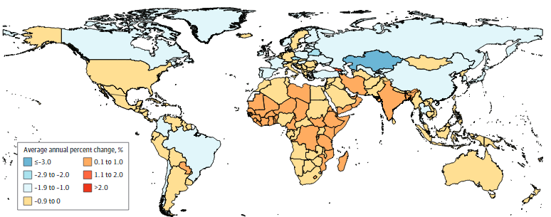
Disparities in cancer deaths
Cancer deaths are rising in LMIC
Global Burden of Diseases Cancer Collaboration JAMA Oncology 2018

Slide 30
Diabetes prevalence worldwide is rising
NCD Risk Factor Collaboration Lancet 2016

Slide 31
Diabetes care cascade in South Africa
Stokes et al. PLoS One 2017

Slide 32
Diabetes care cascade in the US
Ali et al. Ann Int Med 2014

Slide 33
Hypertension leads to serious disease
Kidney disease
Stroke
CVD
Hypertension

Slide 34
Hypertension prevalence globally
Mills et al. Circulation 2016

Slide 35
Hypertension care cascade in Malawi
Price et al. Lancet Diabetes Endocrinol 2018

Slide 36
Depression care cascade in the US
Pence et al. Curr Psychiatry Rep 2012

Slide 37
Care cascades must be improved

Slide 38
Strengthening health systems is essential
Tobacco use, diabetes, hypertension, and depression have intervenable targets to improve outcomes and quality of life
As a model of chronic disease treatment, global HIV care suggests innovations to increase diagnosis, linkage, treatment, and retention

Slide 39
Medications are too often not available
Attaei et al. Lancet Public Health 2017

Slide 40
Medications are too often not available
Attaei et al. Lancet Public Health 2017

Slide 41
Medications are often not affordable
Attaei et al. Lancet Public Health 2017

Slide 42
Medications are often not affordable
Attaei et al. Lancet Public Health 2017

Slide 43
Road map
Challenges and successes of global HIV treatment scale-up
HIV co-exists with a wide range of other health-related issues
Syndemics framework suggests opportunities to maximize impact

Slide 44
Syndemics worsen health outcomes
An increase in the number of “syndemic risk factors” has been associated with worse outcomes
Can we use the syndemics framework to generate innovative solutions that leverage these synergies?
Friedman et al. AIDS 2015; Byg et al. J Community Health 2016;
Tomori et al. Soc Sci Med 2018

Slide 45
Syndemics: platform for innovation
DM
HIV
TB
Economic instability
Food insecurity
Adapted from Tsai et al. Soc Sci Med 2018

Slide 46
Cash transfers
DM
HIV
TB
Economic instability
Food insecurity
Adapted from Tsai et al. Soc Sci Med 2018

Slide 47
Decrease economic instability & food insecurity
DM
HIV
TB
Economic instability
Food insecurity
Adapted from Tsai et al. Soc Sci Med 2018

Slide 48
Improve diagnosis, treatment, retention
DM
HIV
TB
Economic instability
Food insecurity
Adapted from Tsai et al. Soc Sci Med 2018

Slide 49
Prevent new cases & reduce illness and death
DM
HIV
TB
Economic instability
Food insecurity
Adapted from Tsai et al. Soc Sci Med 2018

Slide 50
Turning ideas into reality
Syndemics framework is a theoretical structure to consider real-life challenges but requires ongoing research and outreach to understand synergies better:
Qualitative assessment regarding needs and barriers
Measurements of outcomes: HIV and TB, and also other health outcomes causing morbidity and death
Innovative health care delivery for scale up and sustainability that target syndemics

Slide 51
Conclusions
HIV is one among many major health issues; PWH face multimorbidities intertwined with the health of all
Innovative approaches are essential to address communicable and non-communicable diseases
Syndemics highlight opportunities to address underlying needs by targeting high-impact synergies

Slide 52
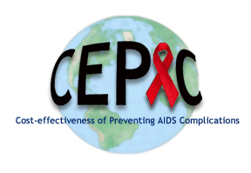
Thank you
Ingrid Bassett, MD MPH
Linda-Gail Bekker, MBChB PhD
Andrea Ciaranello, MD MPH
Sydney Costantini
Caitlin Dugdale, MD
Simone Frank
Kenneth Freedberg, MD MSc
Louise Ivers, MD
Elena Losina, PhD
Emily Martey
Lucia Millham
Anne Neilan, MD MPH
Robert Parker, ScD
Krishna Reddy, MD
Justine Scott, MPH
Madeline Stern
Alexander Tsai, MD
Rochelle Walensky, MD MPH
Milton Weinstein, PhD
Acknowledgments: National Institutes of Health (K01 HL123349)
Our fight against HIV and AIDS is indebted to
people living with HIV both past and present

